Slide 1
Parallel Computing
Ekkapot Charoenwanit
Software Systems Engineering
TGGS
KMUTNB

Slide 2
Lecture 2: Interconnection Networks

Slide 3
Bus-Based Network
In a bus-based network, nodes communicate over a shared medium common to all of them:
Conventionally, a shared medium allows only one message to be sent at a time.
Nodes broadcast their messages over the shared medium:
Each node listens to every message and receives the ones for which it is the destination.
Typically, before sending a message, a processor listens until the medium is not occupied, then attempts to send its message.

Slide 4
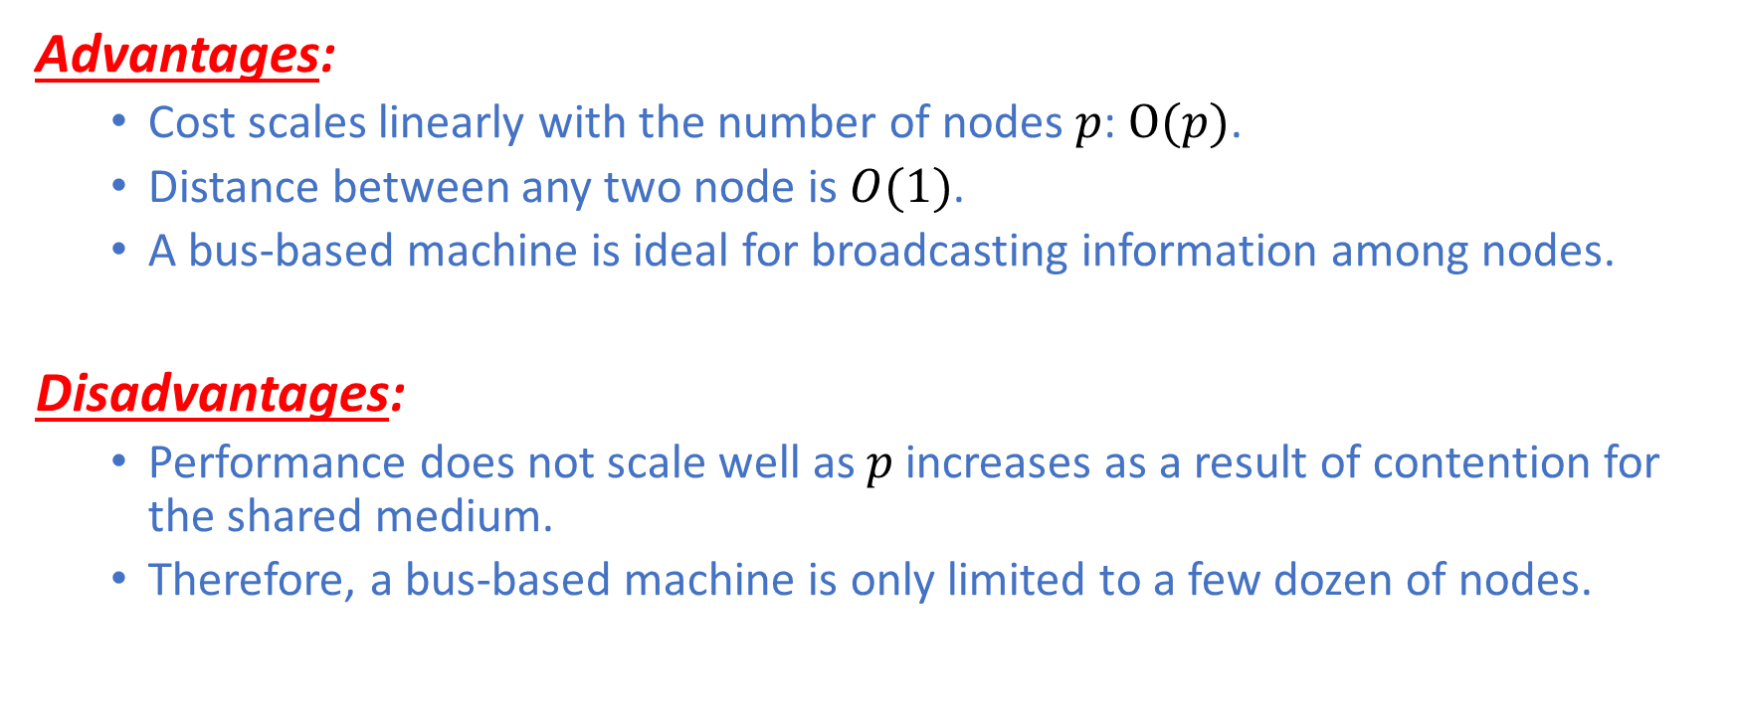
Bus-Based Network
Advantages:
Cost scales linearly with the number of nodes $p$: $O(p)$.
Distance between any two node is $O(1)$.
A bus-based machine is ideal for broadcasting information among nodes.
Disadvantages:
Performance does not scale well as $p$increases as a result of contention for the shared medium.
Therefore, a bus-based machine is only limited to a few dozen of nodes.

Slide 5
Switch Networks
A switch network can be represented as a graph where vertices represent processors and switches, and edges represent communication paths.
Each processor is connected to one switch.
Switches connect processors and/or other switches.

Slide 6

Switch Networks: Diameter
Diameter:
Maximum distance $δ_{max}$ between any two switch nodes
Distance $≝$ Length of a Shortest Path in Terms of Links
The lower, the better.
Determines lower bound on communication time

Slide 7
Switch Networks: Bisection Width
Bisection Width:
Minimum number of links that must be removed in order to divide the network into two halves of equal size or size differing by at most one node
The higher, the better.
Better fault-tolerance
Imagine a network whose bisection width is one. This means removing a certain link will split the network into two halves of equal size. All data that flow from one half to the other must pass through this link, meaning that this link is a bottleneck through which data must flow through sequentially.

Slide 8
Switch Networks: Connectivity and Cost
Connectivity:
Minimum number of links needed to be removed to break the network into two disconnected networks.
The higher, the better.
Measures multiplicity of paths
Cost:
Number of links or switches, depending on which one is asymptotically larger
The smaller, the better.

Slide 9
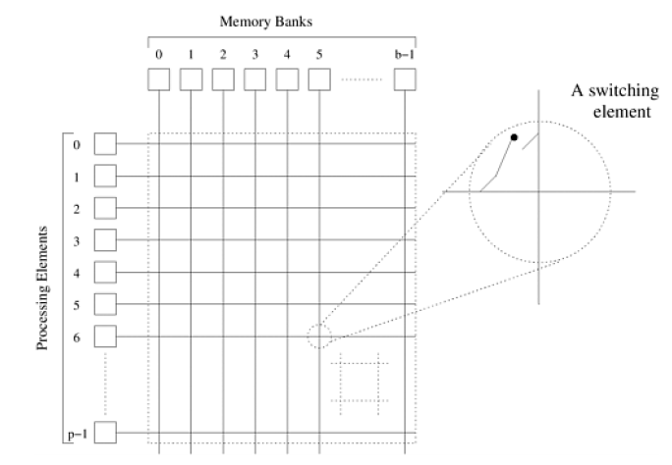
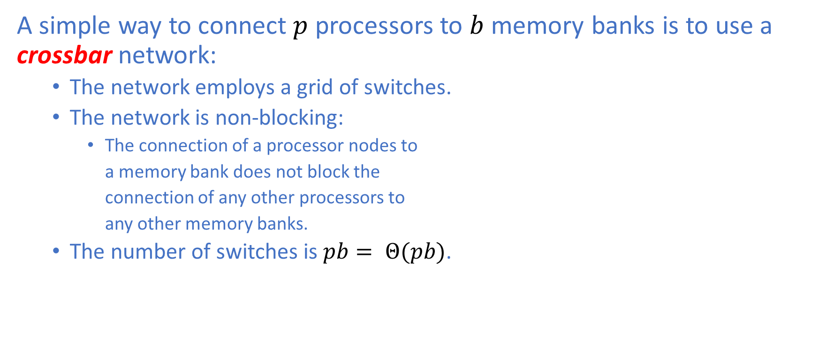
Crossbar Network
A simple way to connect $p$ processors to $b$ memory banks is to use a crossbar network:
The network employs a grid of switches.
The network is non-blocking:
The connection of a processor nodes to
a memory bank does not block the
connection of any other processors to
any other memory banks.
The number of switches is $pb= Θ(pb)$.

Slide 10
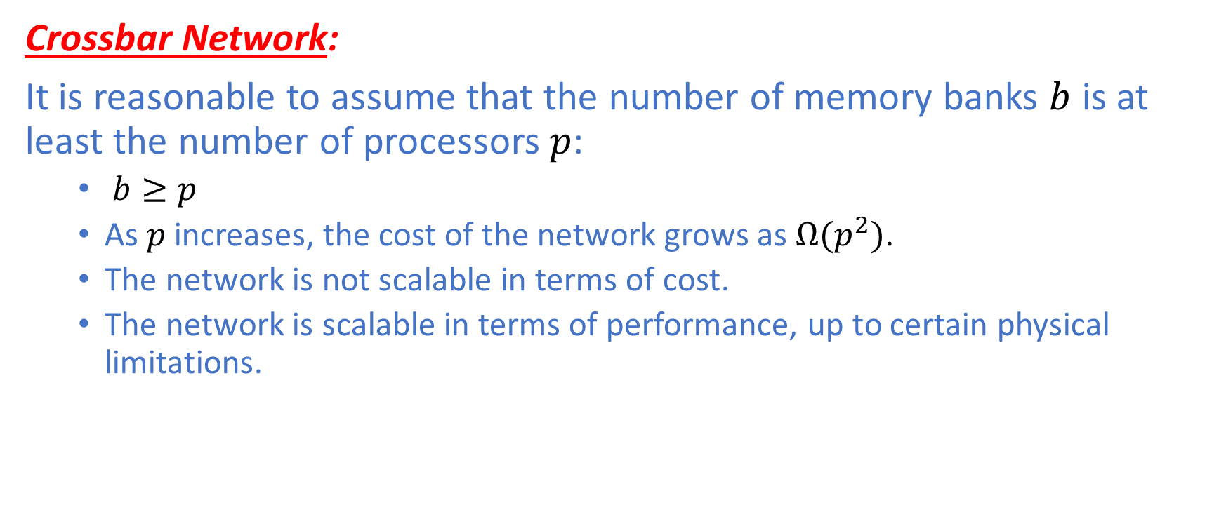
Crossbar Network
Crossbar Network:
It is reasonable to assume that the number of memory banks $b$ is at least the number of processors $p$:
$b≥p$
As $p$ increases, the cost of the network grows as $Ω(p^{2})$.
The network is not scalable in terms of cost.
The network is scalable in terms of performance, up to certain physical limitations.

Slide 11
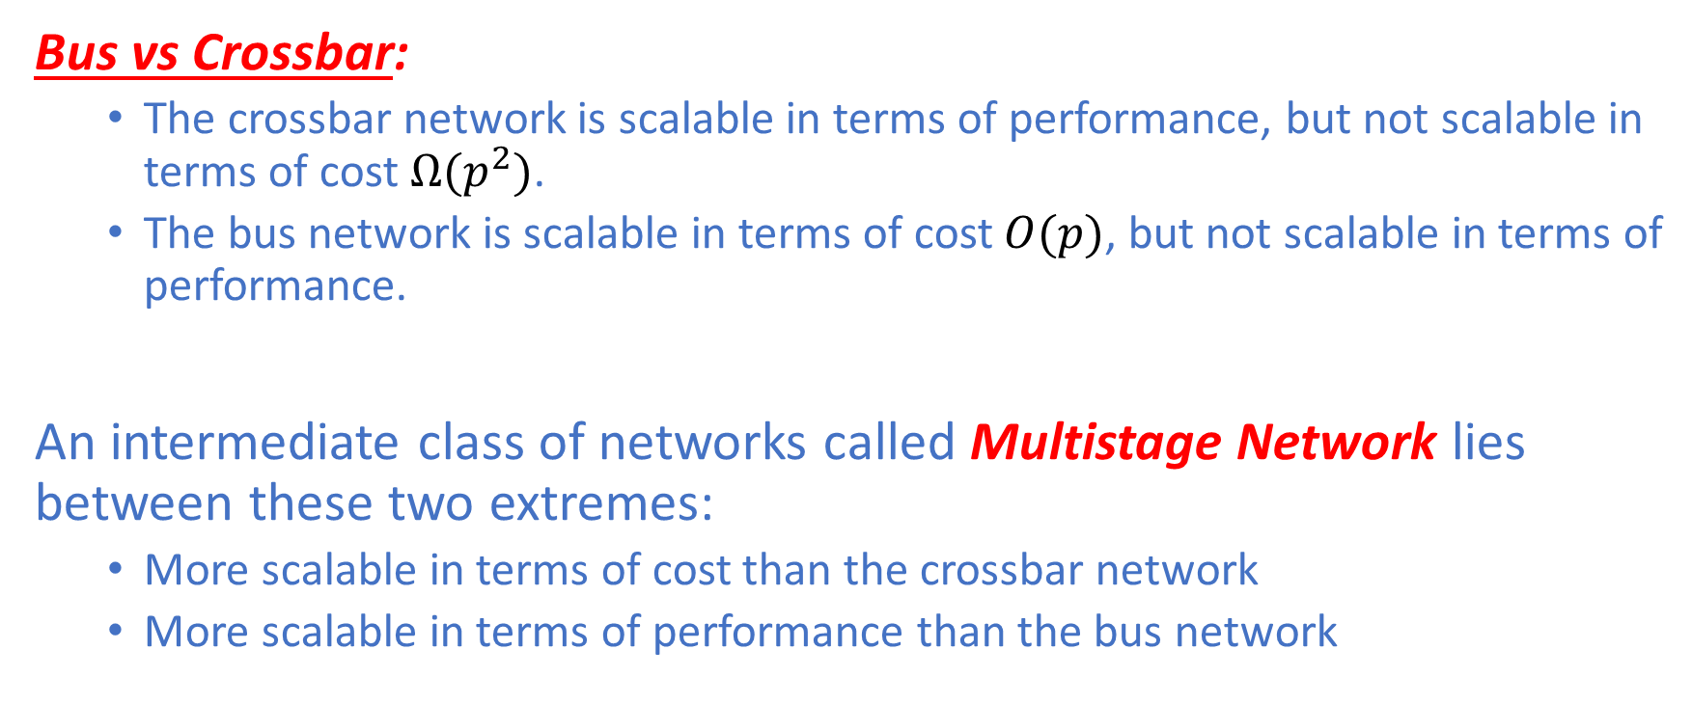
Multistage Network
Bus vs Crossbar:
The crossbar network is scalable in terms of performance, but not scalable in terms of cost $Ω(p^{2})$.
The bus network is scalable in terms of cost $O(p)$, but not scalable in terms of performance.
An intermediate class of networks called Multistage Network lies between these two extremes:
More scalable in terms of cost than the crossbar network
More scalable in terms of performance than the bus network

Slide 12
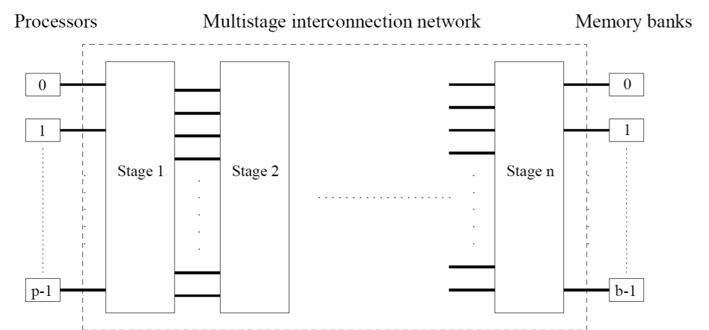

Multistage Network
The diagram shows a general multistage network that connects $p$ processors to $b$ memory banks.

Slide 13
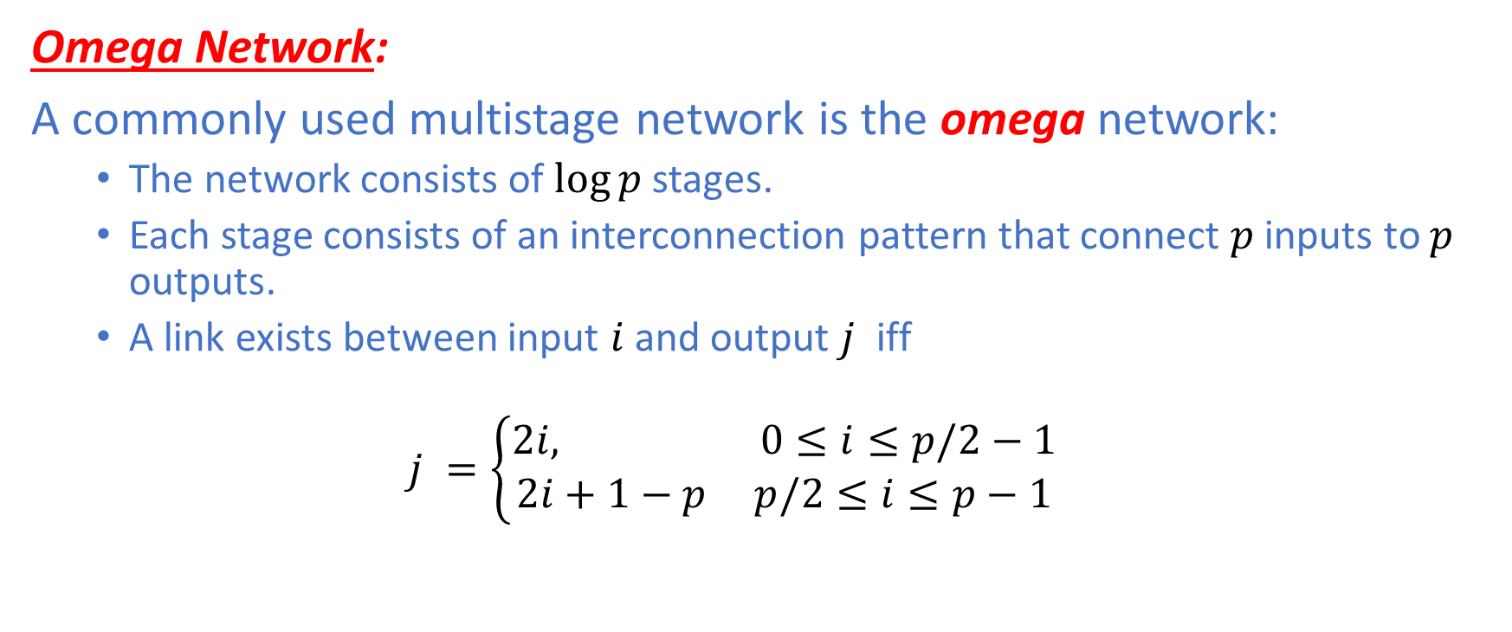
Omega Network
Omega Network:
A commonly used multistage network is the omega network:
The network consists of $\log{p}$ stages.
Each stage consists of an interconnection pattern that connect $p$ inputs to $p$ outputs.
A link exists between input $i$ and output $j$ iff
$$j =\left\{\begin{aligned}2i, 0≤i≤p/2−1 \\ &2i+1−p p/2≤i≤p−1\end{aligned}\right.$$

Slide 14
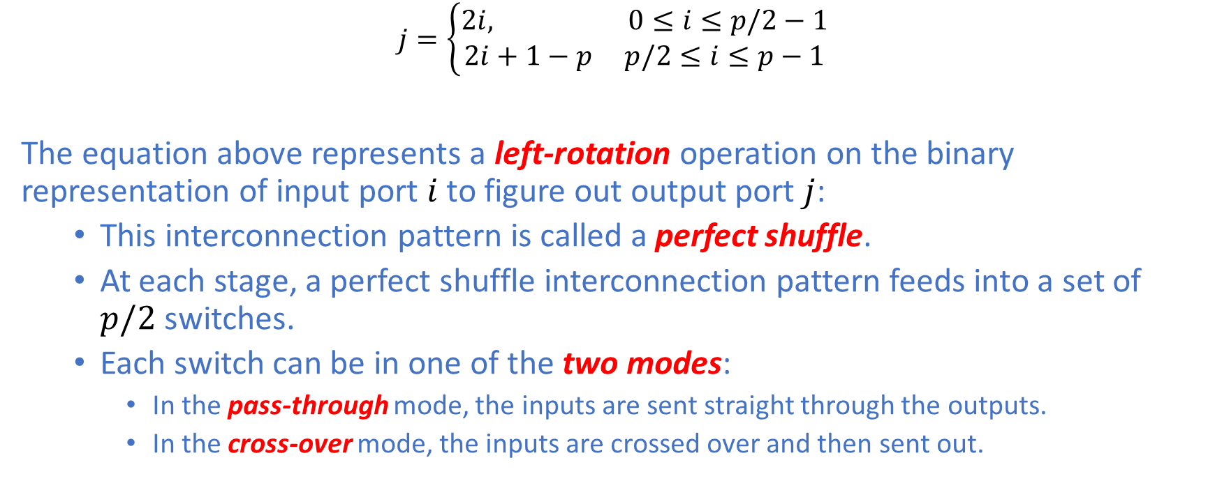
Multistage Network: Omega Network
$$j=\left\{\begin{aligned}2i, 0≤i≤p/2−1 \\ &2i+1−p p/2≤i≤p−1\end{aligned}\right.$$
The equation above represents a left-rotation operation on the binary representation of input port $i$ to figure out output port $j$:
This interconnection pattern is called a perfect shuffle.
At each stage, a perfect shuffle interconnection pattern feeds into a set of $p/2$ switches.
Each switch can be in one of the two modes:
In the pass-through mode, the inputs are sent straight through the outputs.
In the cross-over mode, the inputs are crossed over and then sent out.

Slide 15
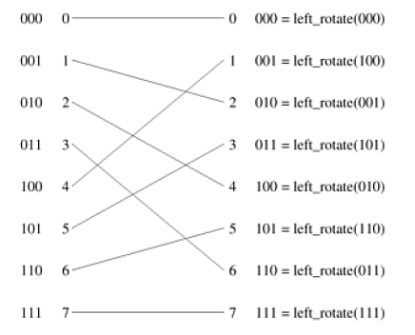
Omega Network

Slide 16
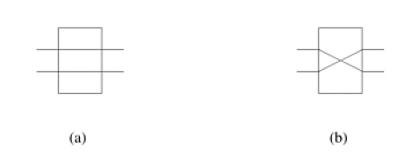
Omega Network
Each switch can be in one of the two modes:
In the pass-through mode, the inputs are sent straight through the outputs as in Figure (a).
In the cross-over mode, the inputs are crossed over and then sent out as in Figure (b).

Slide 17

Multistage Network: Omega Network
The omega network has $\log{p}$ stages, each of which consists of $p/2$ switches:
In total, there are $\frac{p}{2} ∙log{p= Θ(p\log{p)}}$ switches.
Therefore, the cost of the network is $Θ(p\log{p)}$.
This is asymptotically smaller than the cost of the crossbar network $Ω(p^{2})$.

Slide 18
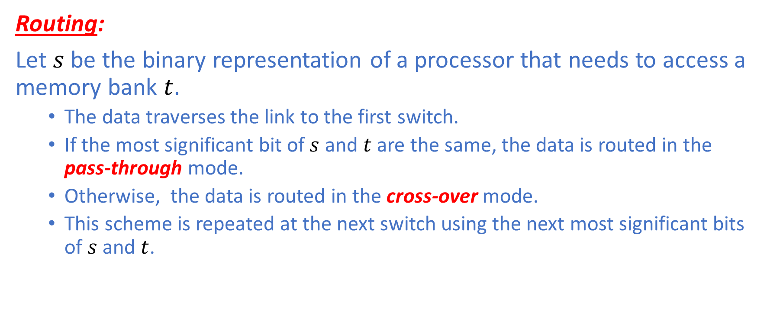
Omega Network
Routing:
Let $s$ be the binary representation of a processor that needs to access a memory bank $t$.
The data traverses the link to the first switch.
If the most significant bit of$s$ and $t$ are the same, the data is routed in the pass-through mode.
Otherwise, the data is routed in the cross-over mode.
This scheme is repeated at the next switch using the next most significant bits of $s$ and $t$.

Slide 19
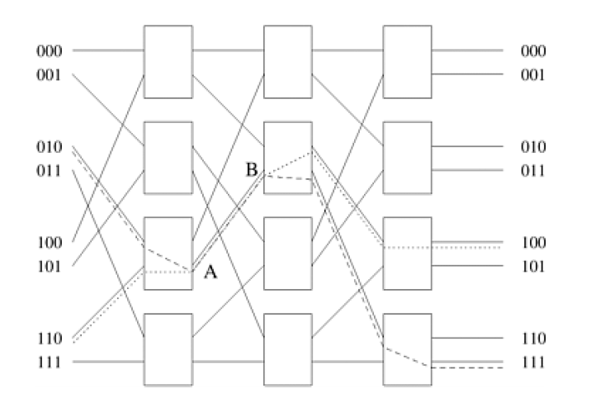
Omega Network
The omega network is a blocking network as can be seen in the figure.
Processors 2 (010) is accessing memory bank 7 (111).
Processors 6 (110) is accessing memory bank 4 (100).
Although the two processors are accessing two different memory banks, there is a contention on the communication link AB as shown in the figure.

Slide 20
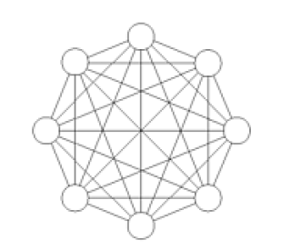
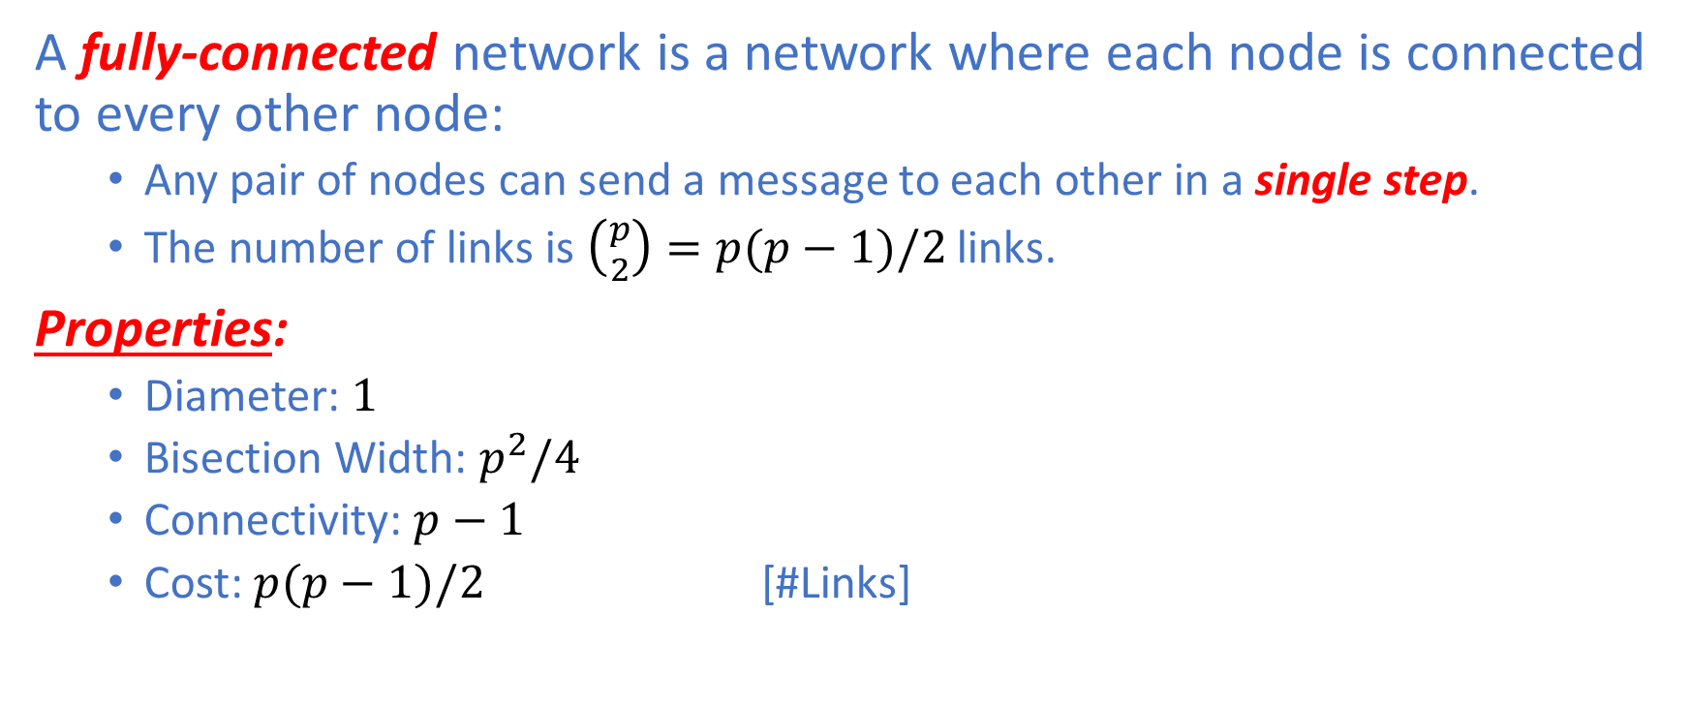
Fully-Connected Network
A fully-connected network is a network where each node is connected to every other node:
Any pair of nodes can send a message to each other in a single step.
The number of links is $\left({p \atop 2}\right)=p(p−1)/2$ links.
Properties:
Diameter: $1$
Bisection Width: $p^{2}/4$
Connectivity: $p−1$
Cost: $p(p−1)/2$ [#Links]

Slide 21


Linear Array Network
Suppose a linear array consists of $p$ processors.
Properties:
Diameter: $p−1$
Bisection Width: $1$
Connectivity: $1$
Cost: $p−1$ [#Links]

Slide 22


1D-Ring Network
Suppose a 1D-ring consists of $p$ processors.
Properties:
Diameter: $p/2$
Bisection Width: $2$
Connectivity: $2$
Cost: $p$ [#Links]

Slide 23
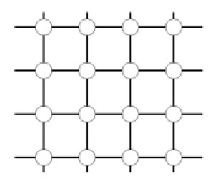
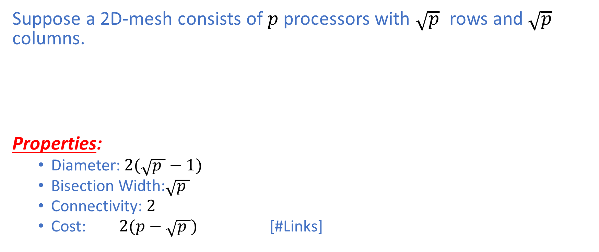
2D-Mesh Network without Wraparound
Suppose a 2D-mesh consists of $p$ processors with $\sqrt{p}$ rows and $\sqrt{p}$ columns.
Properties:
Diameter:$2(\sqrt{p }−1)$
Bisection Width:$\sqrt{p }$
Connectivity: $2$
Cost: $2(p−\sqrt{p })$ [#Links]

Slide 24
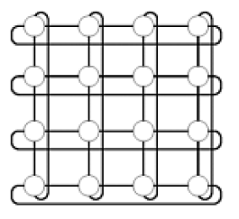

2D-Mesh Network with Wraparound
Suppose a 2D-mesh consists of $p$ processors with $\sqrt{p}$ rows and $\sqrt{p}$ columns.
Properties:
Diameter:$2(\left\lfloor \sqrt{p }/2\right\rfloor )$
Bisection Width:$2\sqrt{p }$
Connectivity: $4$
Cost: $2p$ [#Links]

Slide 25
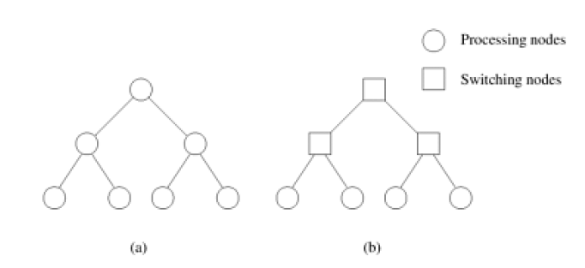
Tree-Based Network
A tree-based network is one where there is only path between any nodes any pair of nodes:
The linear array is a special kind of tree-based networks.
Static Tree: Figure (a)
Dynamic Tree: Figure (b)

Slide 26
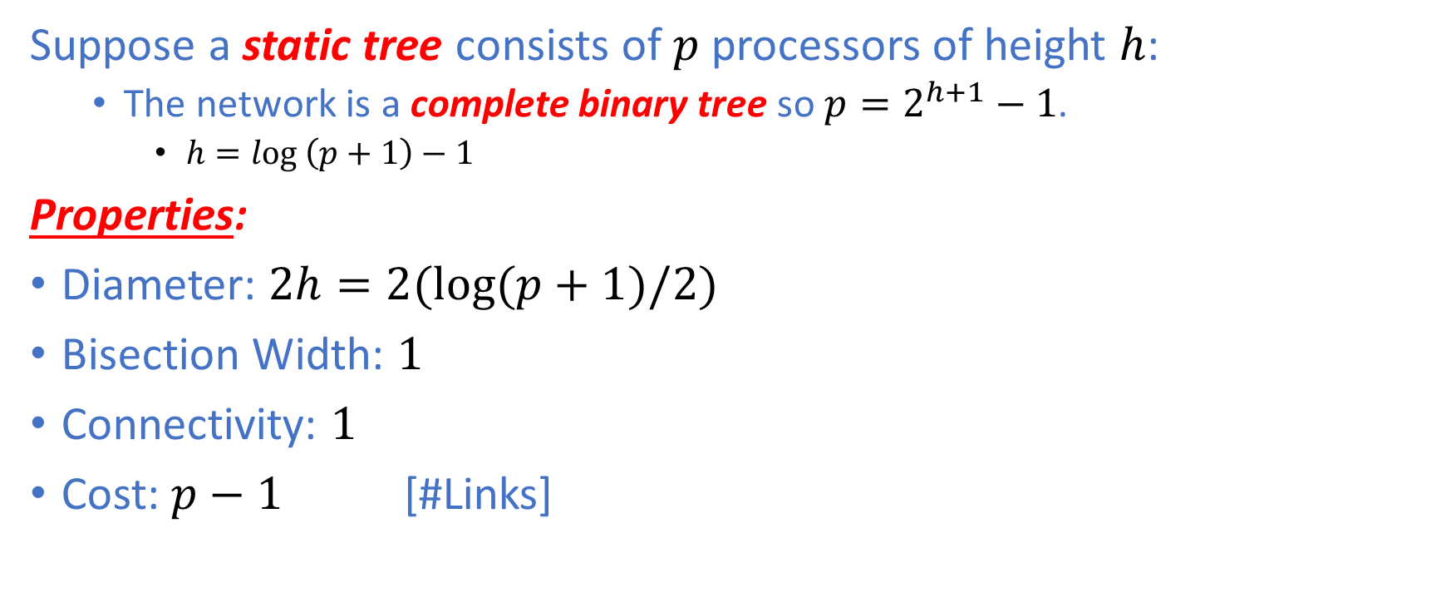
Tree-Based Network: Static Tree
Suppose a static tree consists of $p$ processors of height $h$:
The network is a complete binary tree so $p=2^{h+1}−1$.
$h=log \left(p+1\right)−1$
Properties:
Diameter: $2h=2(\log{(p+1)/2)}$
Bisection Width: $1$
Connectivity: $1$
Cost: $p−1$ [#Links]

Slide 27
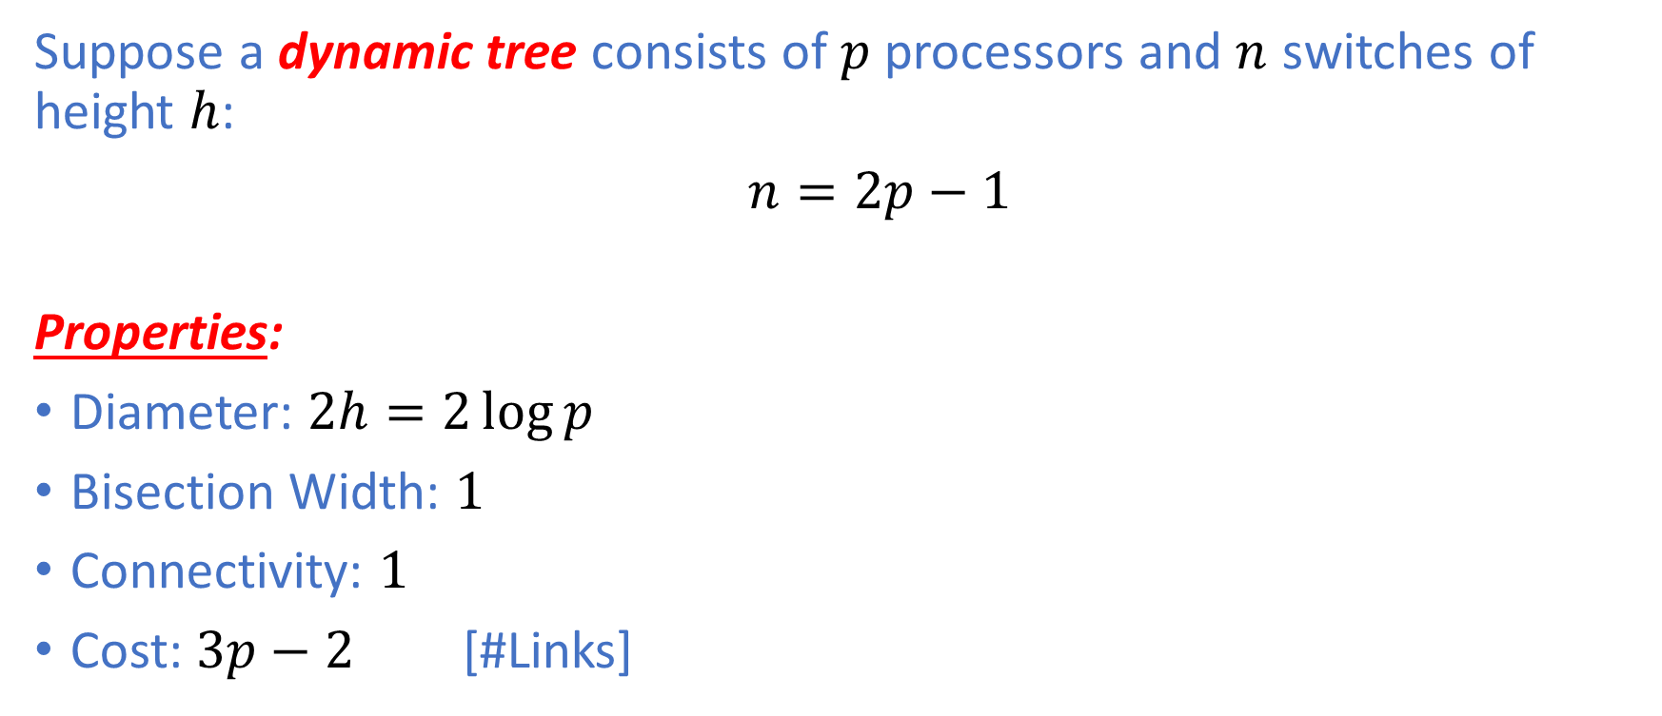
Tree-Based Network: Dynamic Tree
Suppose a dynamic tree consists of $p$ processors and $n$ switches of height $h$:
$n=2p−1$
Properties:
Diameter: $2h=2\log{p}$
Bisection Width: $1$
Connectivity: $1$
Cost: $3p−2$ [#Links]

Slide 28
Tree-Based Network
Routing:
To route a message, the source node sends the message up the tree until the node at the root of the smallest subtree that contains both source and destination nodes.
Therefore, tree-based networks suffer from a communication bottleneck at higher levels of the tree.
Imagine many nodes in the left subtree of a node communicate with many nodes in the right subtree.
Under such a circumstance, the root node must handle all the messages.

Slide 29
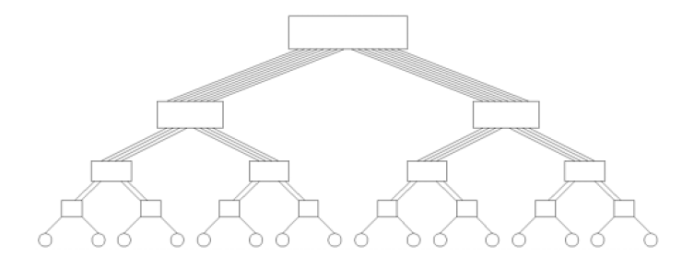
Tree-Based Network
The communication bottleneck at higher levels of a tree-based network can be alleviated in dynamic tree networks by increasing the number of communication links and switching nodes closer to the root.
This network is called a fat tree.

Slide 30
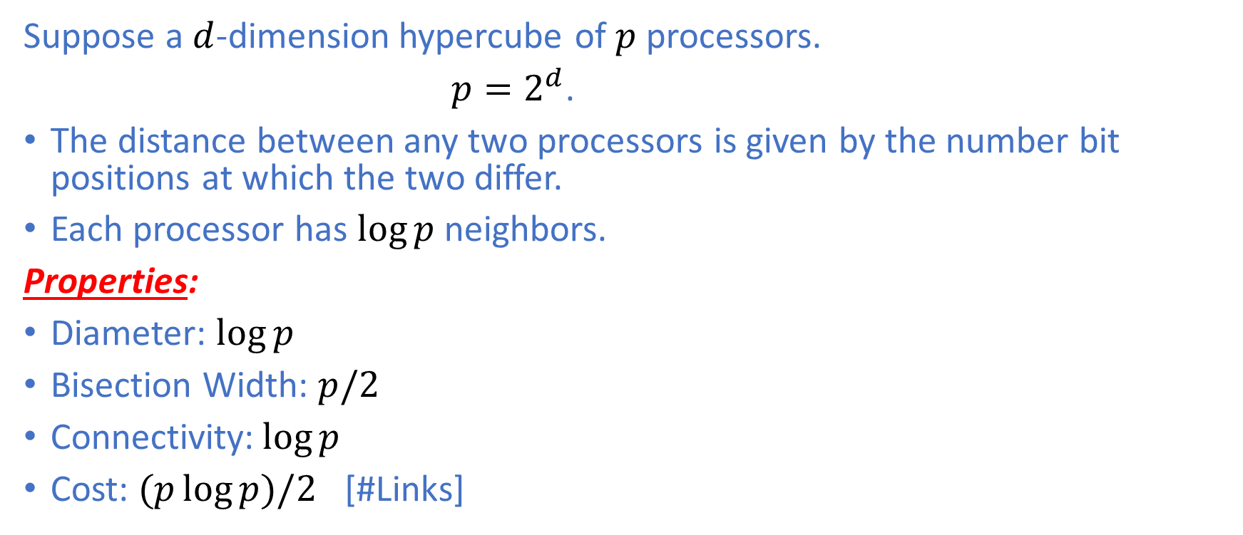
Hypercube
Suppose a $d$-dimension hypercube of $p$ processors.
$p=2^{d}$.
The distance between any two processors is given by the number bit positions at which the two differ.
Each processor has $\log{p}$ neighbors.
Properties:
Diameter: $\log{p}$
Bisection Width: $p/2$
Connectivity:$\log{p}$
Cost: $(p\log{p)/2 }$ [#Links]

Slide 31
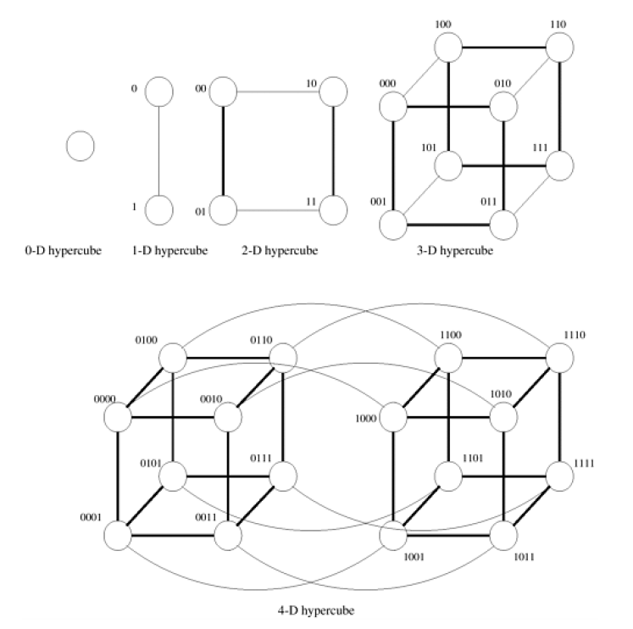

Hypercube
In general, a $d$-dimensional hypercube is constructed by connecting corresponding nodes of two $(d−1)$ dimensional hypercubes.

Slide 32
Communication Cost
One of the major overheads in the execution of parallel programs arises from the exchange of data between processors.
The cost of communication depends on a variety of factors such as the parallel programming paradigm, the network topology, data handling and routing, as well as associated software protocols.
In this lecture, we will focus on Message Passing cost.

Slide 33

Message Passing Cost
The time taken to communicate a message between two processors is the sum of the following three components:
Startup time $t_{s}$
Per-hop time $t_{h}$
Per-word transfer time $t_{w}$

Slide 34
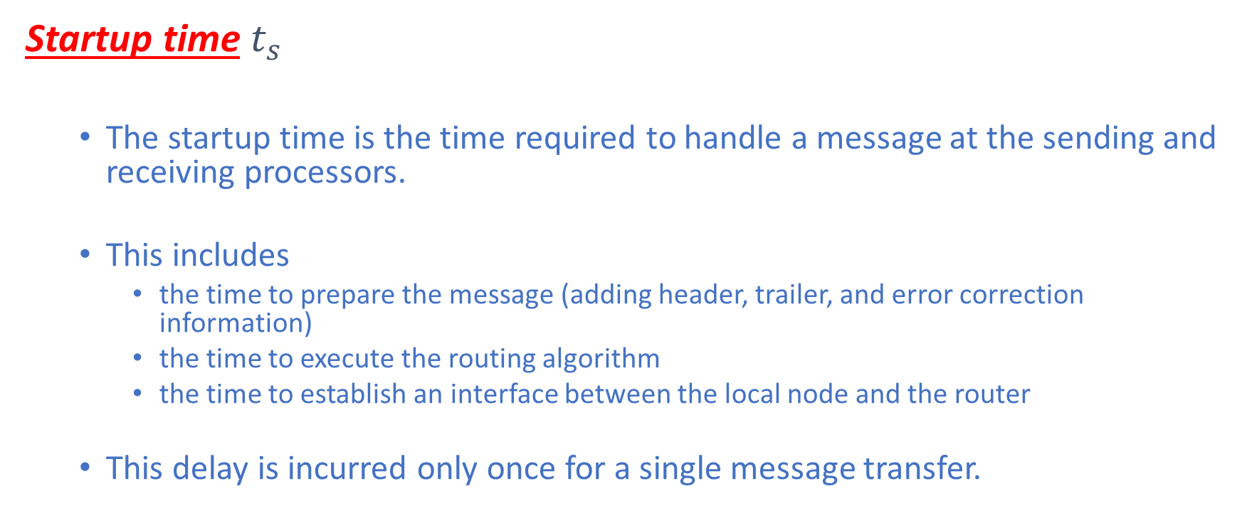
Message Passing Cost
Startup time $t_{s}$
The startup time is the time required to handle a message at the sending and receiving processors.
This includes
the time to prepare the message (adding header, trailer, and error correction information)
the time to execute the routing algorithm
the time to establish an interface between the local node and the router
This delay is incurred only once for a single message transfer.

Slide 35
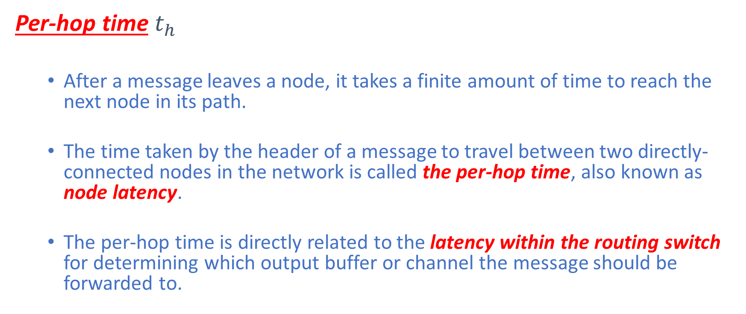
Message Passing Cost
Per-hop time $t_{h}$
After a message leaves a node, it takes a finite amount of time to reach the next node in its path.
The time taken by the header of a message to travel between two directly-connected nodes in the network is called the per-hop time, also known as node latency.
The per-hop time is directly related to the latency within the routing switch for determining which output buffer or channel the message should be forwarded to.

Slide 36
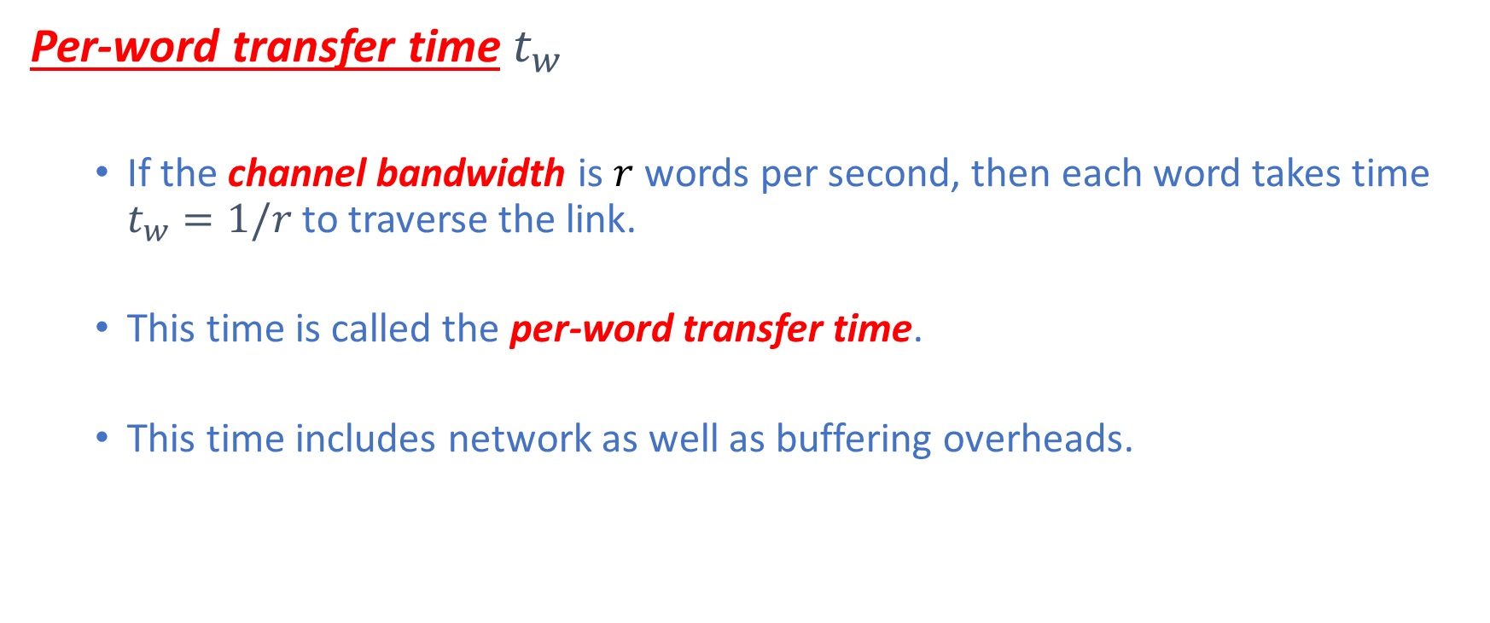
Message Passing Cost
Per-word transfer time $t_{w}$
If the channel bandwidth is $r$ words per second, then each word takes time $t_{w}=1/r$ to traverse the link.
This time is called the per-word transfer time.
This time includes network as well as buffering overheads.

Slide 37
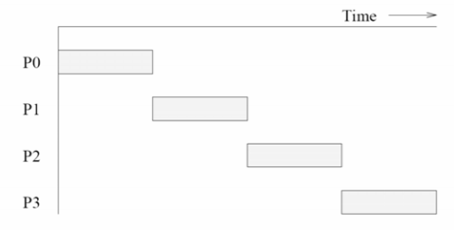
Store-and-Forward Routing
Store-and-Forward Routing
A switching node forwards a message to the next node only after it has received and stored the entire message.

Slide 38
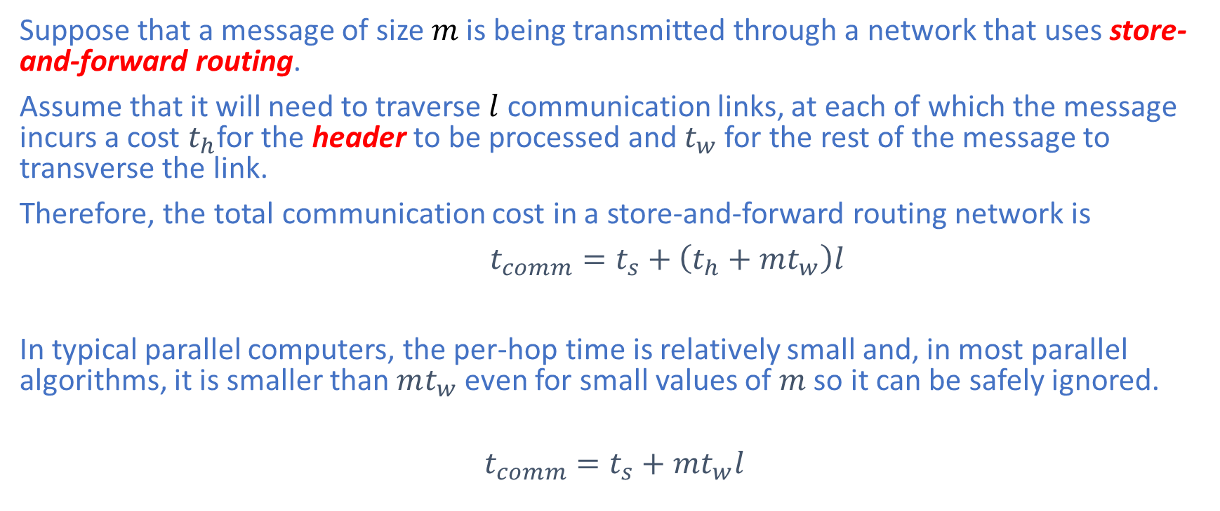
Store-and-Forward Routing
Suppose that a message of size $m$ is being transmitted through a network that uses store-and-forward routing.
Assume that it will need to traverse $l$ communication links, at each of which the message incurs a cost $t_{h}$for the header to be processed and $t_{w}$ for the rest of the message to transverse the link.
Therefore, the total communication cost in a store-and-forward routing network is
$t_{comm}=t_{s}+\left(t_{h}+mt_{w}\right)l$
In typical parallel computers, the per-hop time is relatively small and, in most parallel algorithms, it is smaller than $mt_{w}$even for small values of $m$ so it can be safely ignored.
$t_{comm}=t_{s}+mt_{w}l$

Slide 39
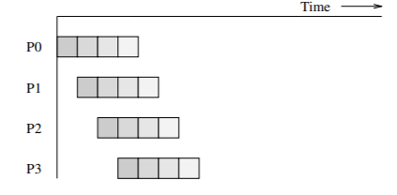
Packet Routing
Store-and-Forward outing makes poor use of communication resources.
In packet routing, messages are broken into packets (of smaller size) and pipeline them through network.
Packets may take different paths so each packet must carry routing, error-checking and sequencing information.

Slide 40
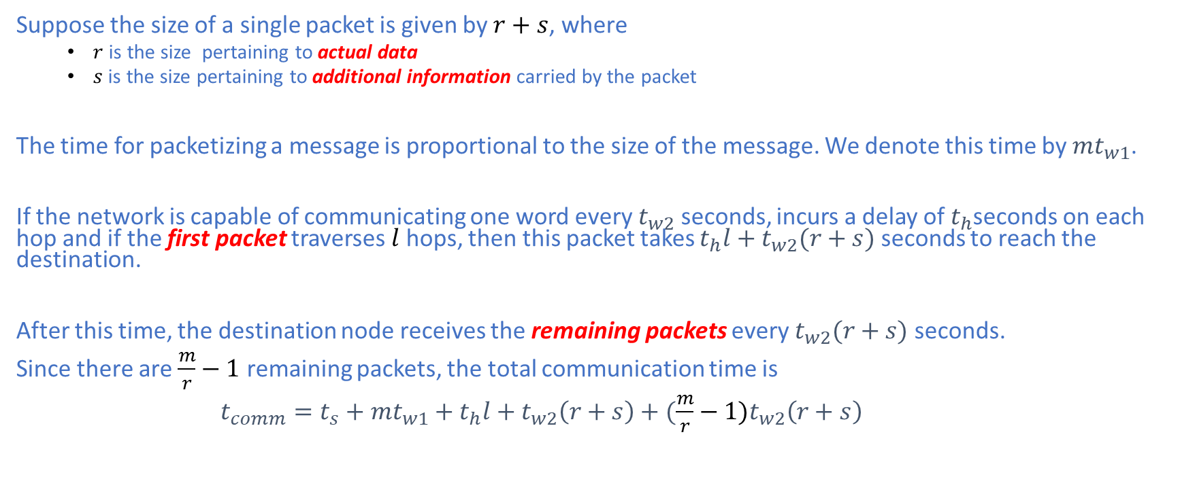
Packet Routing
Suppose the size of a single packet is given by $r+s$, where
$r$ is the size pertaining to actual data
$s$ is the size pertaining to additional information carried by the packet
The time for packetizing a message is proportional to the size of the message. We denote this time by ${mt}_{w1}$.
If the network is capable of communicating one word every $t_{w2}$ seconds, incurs a delay of $t_{h}$seconds on each hop and if the first packet traverses $l$ hops, then this packet takes $t_{h}l+t_{w2}(r+s)$ seconds to reach the destination.
After this time, the destination node receives the remaining packets every $t_{w2}(r+s)$ seconds.
Since there are $\frac{m}{r}−1$ remaining packets, the total communication time is
$t_{comm}=t_{s}+{mt}_{w1}+t_{h}l+t_{w2}\left(r+s\right)+(\frac{m}{r}−1)t_{w2}\left(r+s\right)$

Slide 41
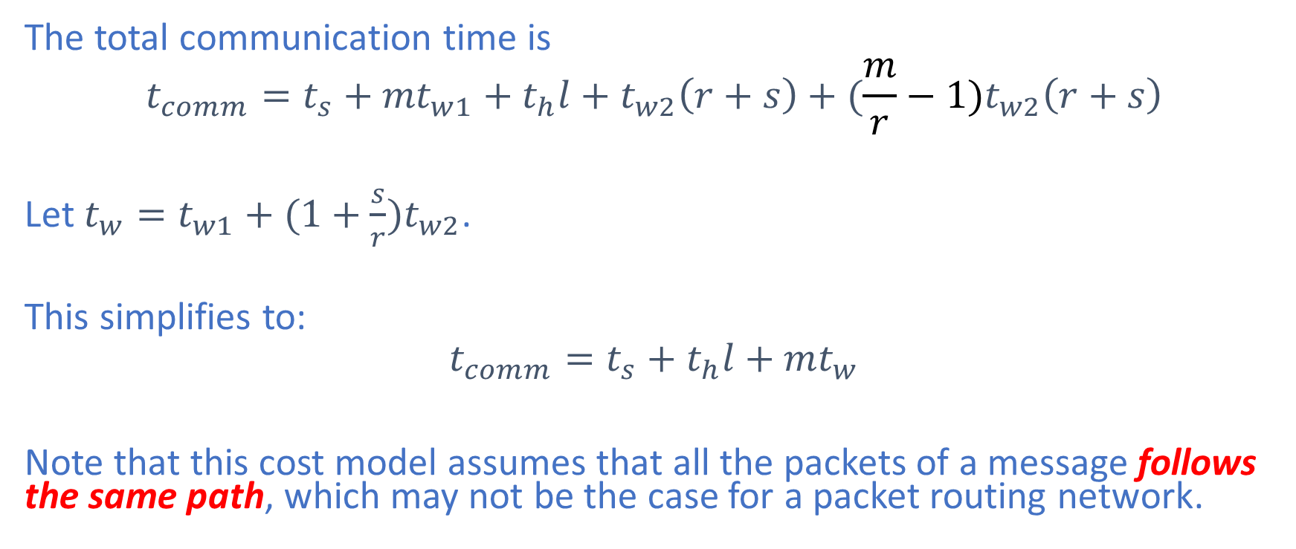
Packet Routing
The total communication time is
$$t_{comm}=t_{s}+{mt}_{w1}+t_{h}l+t_{w2}\left(r+s\right)+(\frac{m}{r}−1)t_{w2}\left(r+s\right)$$
Let ${t_{w}=t}_{w1}+{(1+\frac{s}{r})t}_{w2}$.
This simplifies to:
$$t_{comm}=t_{s}+t_{h}l+mt_{w}$$
Note that this cost model assumes that all the packets of a message follows the same path, which may not be the case for a packet routing network.

Slide 42
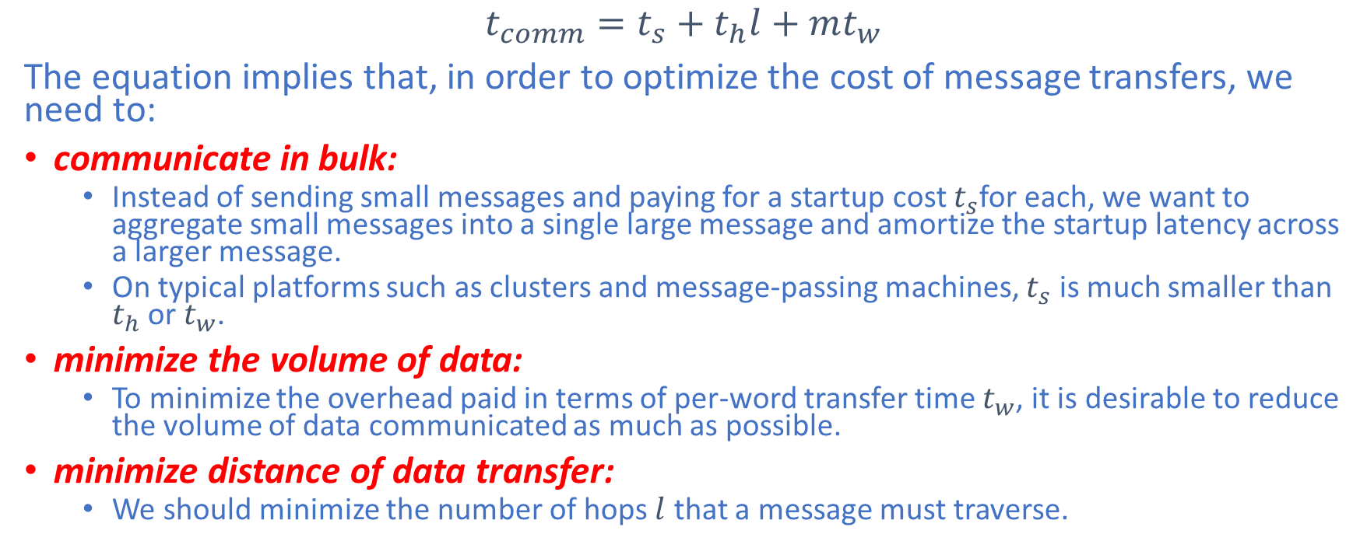
Simplified Cost Model
$$t_{comm}=t_{s}+t_{h}l+mt_{w}$$
The equation implies that, in order to optimize the cost of message transfers, we need to:
communicate in bulk:
Instead of sending small messages and paying for a startup cost $t_{s}$for each, we want to aggregate small messages into a single large message and amortize the startup latency across a larger message.
On typical platforms such as clusters and message-passing machines, $t_{s}$ is much smaller than $t_{h}$ or $t_{w}$.
minimize the volume of data:
To minimize the overhead paid in terms of per-word transfer time $t_{w}$, it is desirable to reduce the volume of data communicated as much as possible.
minimize distance of data transfer:
We should minimize the number of hops $l$ that a message must traverse.

Slide 43
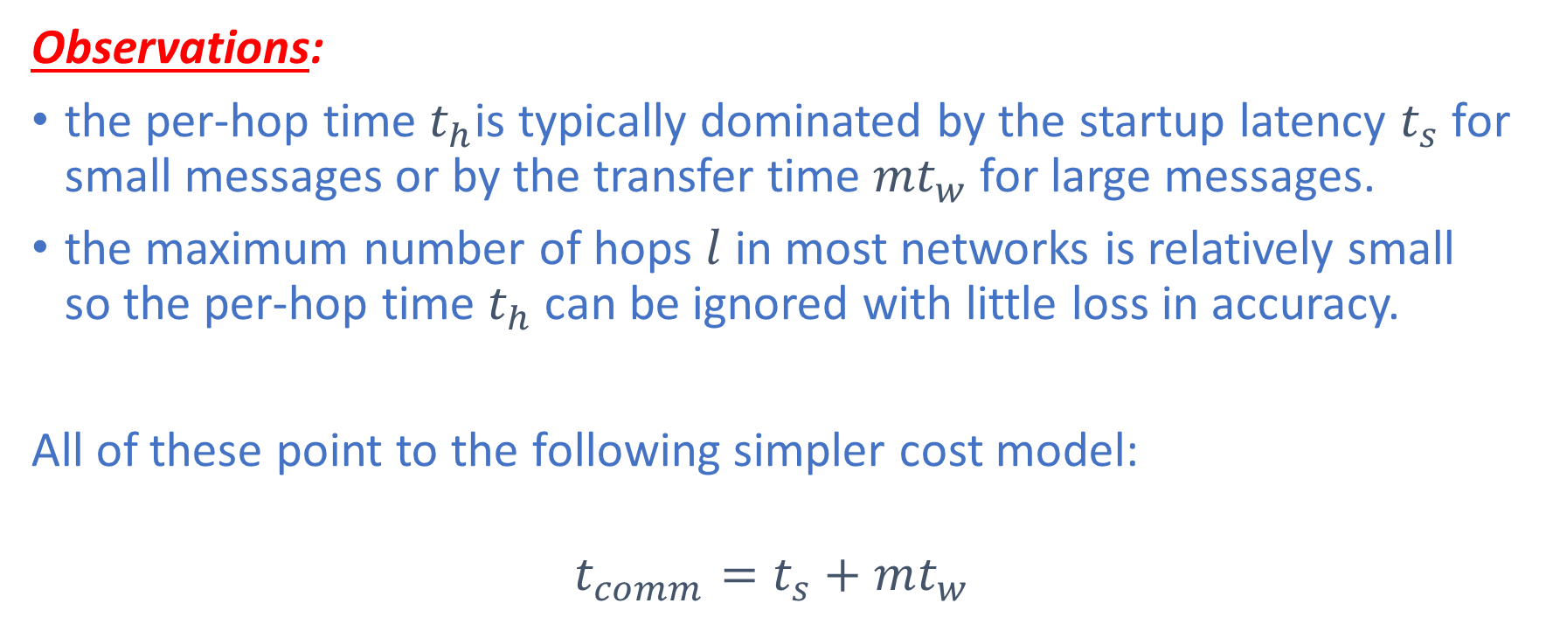
Simplified Cost Model
Observations:
the per-hop time $t_{h}$is typically dominated by the startup latency $t_{s}$ for small messages or by the transfer time ${mt}_{w}$ for large messages.
the maximum number of hops $l$ in most networks is relatively small so the per-hop time $t_{h}$can be ignored with little loss in accuracy.
All of these point to the following simpler cost model:
$$t_{comm}=t_{s}+mt_{w}$$

Slide 44
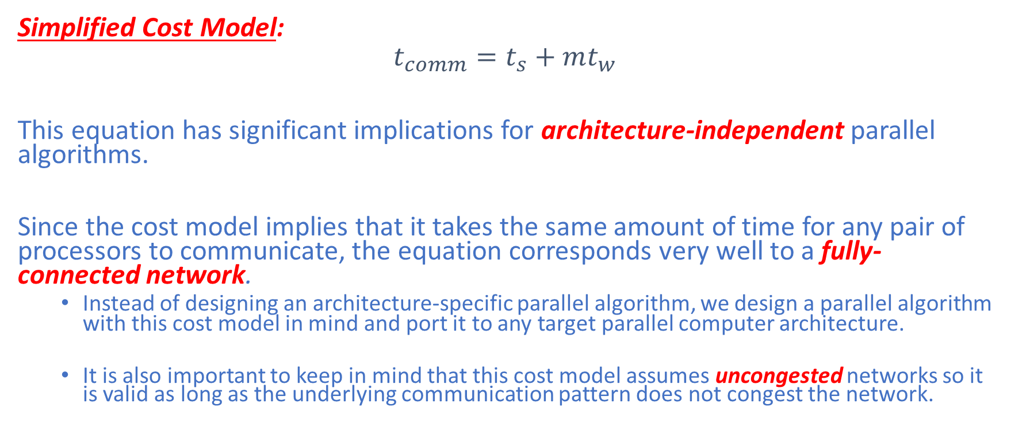
Simplified Cost Model
Simplified Cost Model:
$$t_{comm}=t_{s}+mt_{w}$$
This equation has significant implications for architecture-independent parallel algorithms.
Since the cost model implies that it takes the same amount of time for any pair of processors to communicate, the equation corresponds very well to a fully-connected network.
Instead of designing an architecture-specific parallel algorithm, we design a parallel algorithm with this cost model in mind and port it to any target parallel computer architecture.
It is also important to keep in mind that this cost model assumes uncongested networks so it is valid as long as the underlying communication pattern does not congest the network.

Slide 45
References
[1] Michael J. Quinn. 2003. Parallel Programming in C with MPI and OpenMP. McGraw-Hill Education Group.
[2] Vipin Kumar, Ananth Grama, Anshul Gupta, and George Karypis. 1994. Introduction to parallel computing: design and analysis of algorithms. Benjamin-Cummings Publishing Co., Inc., USA.

